Slide 1
Recursion

Slide 2

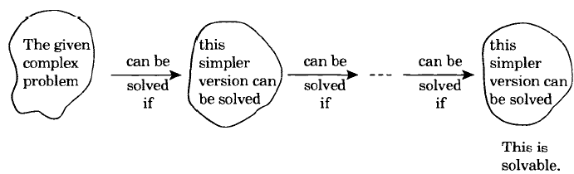
Recursion
What is Recursion?
Dictionary definition:
A problem-solving method of
“decomposing bigger problems into smaller sub-problems that are identical to itself.”
Recursion:
Process of solving a problem by reducing it to smaller versions of itself

Slide 3
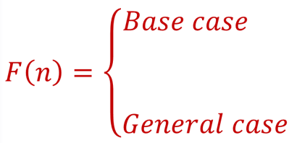
Recursion
What is Recursion?
There are two key point in recursion
How to decompose bigger problem into smaller problem?
When to stop decomposing problem
Base case:
Case in recursive definition in which the solution is obtained directly.
Stops the recursion.
General case:
Case in recursive definition in which a smaller version of itself is called.
Must eventually be reduced to a base case.

Slide 4
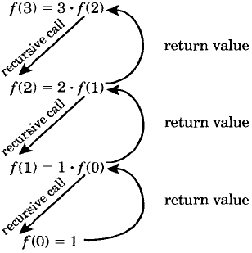
Recursion
What is Recursion? UPSHOT
General Idea:
Solve simplest (smallest) cases DIRECTLY
usually these are very easy to solve
Solve bigger problems using smaller sub-problems
that are identical to itself (but smaller and simpler)

Slide 5
RECURSIVELY DEFINED FUNCTIONS
A function is said to be recursively defined if the function refers to itself such that
1. There are certain arguments, called base values, for which the function does not refer to itself.
2. Each time the function does refer to itself, the argument of the function must be closer to a base value.

Slide 6
Recursion
Recursion in java is a process in which a method calls itself continuously
A method in java that calls itself is called recursive method
It makes the code compact but complex to understand
Syntax:
returntype methodname(){
//code to be executed
methodname();//calling same method
}

Slide 7
Example-1 (Infinite Times)
public static void main(String[] args){
infiniteMethod();
}
public static void infiniteMethod(){
System.out.println("infinite Recursion");
infiniteMethod();
}

Slide 8
Example-2 (Finite Times)
static int count=0;
public static void main(String[] args){
finiteMethod();
}
public static void finiteMethod(){
if(count<=5){
System.out.println(count+" Finite Method");
count++;
finiteMethod();
}
}

Slide 9
Characteristics of Recursion
All recursive methods have the following characteristics:
One or more base cases (the simplest case) are used to stop recursion.
Every recursive call reduces the original problem, bringing it increasingly closer to a base case until it becomes that case.
In general, to solve a problem using recursion, you break it into subproblems. If a subproblem resembles the original problem, you can apply the same approach to solve the subproblem recursively. This subproblem is almost the same as the original problem in nature with a smaller size.

Slide 10
Computing Factorial
factorial(0) = 1;
factorial(n) = n*factorial(n-1);
//this are math rules
Base Case: 0! = 1
Recurssive Case: n! = n * (n-1)!

Slide 11
Computing Factorial
factorial(0) = 1;
factorial(n) = n*factorial(n-1);
factorial(4)

Slide 12
Computing Factorial
factorial(0) = 1;
factorial(n) = n*factorial(n-1);
factorial(4) = 4 * factorial(3)

Slide 13
Computing Factorial
factorial(0) = 1;
factorial(n) = n*factorial(n-1);
factorial(4) = 4 * factorial(3)
= 4 * 3 * factorial(2)

Slide 14
Computing Factorial
factorial(0) = 1;
factorial(n) = n*factorial(n-1);
factorial(4) = 4 * factorial(3)
= 4 * 3 * factorial(2)
= 4 * 3 * (2 * factorial(1))

Slide 15
Computing Factorial
factorial(0) = 1;
factorial(n) = n*factorial(n-1);
factorial(4) = 4 * factorial(3)
= 4 * 3 * factorial(2)
= 4 * 3 * (2 * factorial(1))
= 4 * 3 * ( 2 * (1 * factorial(0)))

Slide 16
Computing Factorial
factorial(0) = 1;
factorial(n) = n*factorial(n-1);
factorial(4) = 4 * factorial(3)
= 4 * 3 * factorial(2)
= 4 * 3 * (2 * factorial(1))
= 4 * 3 * ( 2 * (1 * factorial(0)))
= 4 * 3 * ( 2 * ( 1 * 1)))

Slide 17
Computing Factorial
factorial(0) = 1;
factorial(n) = n*factorial(n-1);
factorial(4) = 4 * factorial(3)
= 4 * 3 * factorial(2)
= 4 * 3 * (2 * factorial(1))
= 4 * 3 * ( 2 * (1 * factorial(0)))
= 4 * 3 * ( 2 * ( 1 * 1)))
= 4 * 3 * ( 2 * 1)

Slide 18
Computing Factorial
factorial(0) = 1;
factorial(n) = n*factorial(n-1);
factorial(4) = 4 * factorial(3)
= 4 * 3 * factorial(2)
= 4 * 3 * (2 * factorial(1))
= 4 * 3 * ( 2 * (1 * factorial(0)))
= 4 * 3 * ( 2 * ( 1 * 1)))
= 4 * 3 * ( 2 * 1)
= 4 * 3 * 2

Slide 19
Computing Factorial
factorial(0) = 1;
factorial(n) = n*factorial(n-1);
factorial(4) = 4 * factorial(3)
= 4 * (3 * factorial(2))
= 4 * (3 * (2 * factorial(1)))
= 4 * (3 * ( 2 * (1 * factorial(0))))
= 4 * (3 * ( 2 * ( 1 * 1))))
= 4 * (3 * ( 2 * 1))
= 4 * (3 * 2)
= 4 * (6)

Slide 20
Computing Factorial
factorial(0) = 1;
factorial(n) = n*factorial(n-1);
factorial(4) = 4 * factorial(3)
= 4 * (3 * factorial(2))
= 4 * (3 * (2 * factorial(1)))
= 4 * (3 * ( 2 * (1 * factorial(0))))
= 4 * (3 * ( 2 * ( 1 * 1))))
= 4 * (3 * ( 2 * 1))
= 4 * (3 * 2)
= 4 * (6)
= 24

Slide 21
Trace Recursive factorial
Executes factorial(4)

Slide 22
Trace Recursive factorial
Executes factorial(3)

Slide 23
Trace Recursive factorial
Executes factorial(2)

Slide 24
Trace Recursive factorial
Executes factorial(1)

Slide 25
Trace Recursive factorial
Executes factorial(0)

Slide 26
Trace Recursive factorial
returns 1

Slide 27
Trace Recursive factorial
returns factorial(0)

Slide 28
Trace Recursive factorial
returns factorial(1)

Slide 29
Trace Recursive factorial
returns factorial(2)

Slide 30
Trace Recursive factorial
returns factorial(3)

Slide 31
Trace Recursive factorial
returns factorial(4)

Slide 32
factorial(4) Stack Trace

Slide 33
Fibonacci Numbers
Fibonacci series: 0 1 1 2 3 5 8 13 21 34 55 89…
indices: 0 1 2 3 4 5 6 7 8 9 10 11
fib(0) = 0;
fib(1) = 1;
fib(index) = fib(index -1) + fib(index -2); index >=2
fib(3) = fib(2) + fib(1) = (fib(1) + fib(0)) + fib(1) = (1 + 0) +fib(1) = 1 + fib(1) = 1 + 1 = 2

Slide 34
Fibonnaci Numbers, cont.

Slide 35
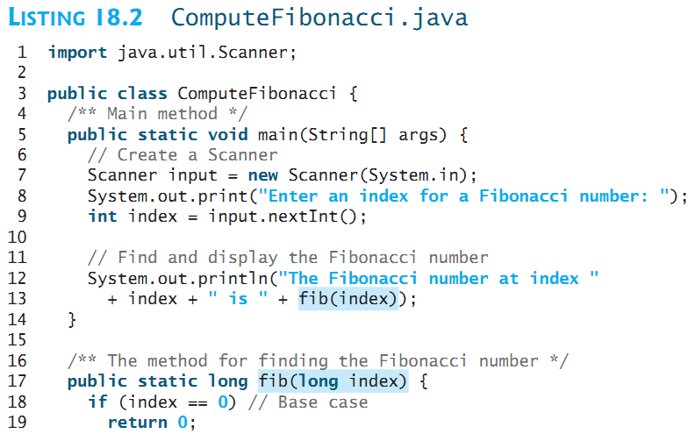
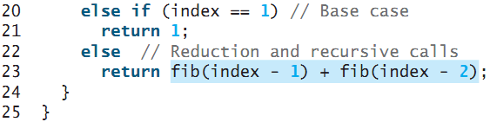

Slide 36
Think Recursively
Many of the problems presented in the early chapters can be solved using recursion if you think recursively. For example, the palindrome problem can be solved recursively as follows:
public static boolean isPalindrome(String s) {
if (s.length() <= 1) // Base case
return true;
else if (s.charAt(0) != s.charAt(s.length() - 1)) // Base case
return false;
else
return isPalindrome(s.substring(1, s.length() - 1));
}

Slide 37
Recursive Helper Methods
The preceding recursive isPalindrome method is not efficient, because it creates a new string for every recursive call. To avoid creating new strings, use a helper method:
public static boolean isPalindrome(String s) {
return isPalindrome(s, 0, s.length() - 1);
}
public static boolean isPalindrome(String s, int low, int high) {
if (high <= low) // Base case
return true;
else if (s.charAt(low) != s.charAt(high)) // Base case
return false;
else
return isPalindrome(s, low + 1, high - 1);
}

Slide 38
Recursive Selection Sort
Find the smallest number in the list and swaps it with the first number.
Ignore the first number and sort the remaining smaller list recursively.

Slide 39
Recursive Binary Search
Case 1: If the key is less than the middle element, recursively search the key in the first half of the array.
Case 2: If the key is equal to the middle element, the search ends with a match.
Case 3: If the key is greater than the middle element, recursively search the key in the second half of the array.

Slide 40
Recursive Implementation
/** Use binary search to find the key in the list */
public static int recursiveBinarySearch(int[] list, int key) {
int low = 0;
int high = list.length - 1;
return recursiveBinarySearch(list, key, low, high);
}
/** Use binary search to find the key in the list between
list[low] list[high] */
public static int recursiveBinarySearch(int[] list, int key,
int low, int high) {
if (low > high) // The list has been exhausted without a match
return -low - 1;
int mid = (low + high) / 2;
if (key < list[mid])
return recursiveBinarySearch(list, key, low, mid - 1);
else if (key == list[mid])
return mid;
else
return recursiveBinarySearch(list, key, mid + 1, high);
}

Slide 41
Recursion vs. Iteration
Recursion is an alternative form of program control. It is essentially repetition without a loop.
Recursion bears substantial overhead. Each time the program calls a method, the system must assign space for all of the method’s local variables and parameters. This can consume considerable memory and requires extra time to manage the additional space.

Slide 42
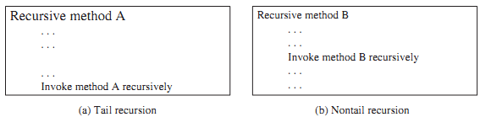
Tail Recursion
A recursive method is said to be tail recursive if there are no pending operations to be performed on return from a recursive call.

Slide 43
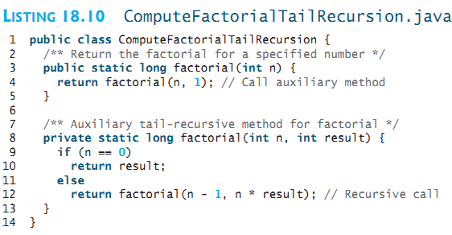

Tail recursive
Non-tail recursive

